Slide 1
Machine Learning I fatality prediction of road accidents
Buğra Duman
KaMIL Matuszelański

Slide 2
Scope
General information
EDA
Modeling

Slide 3
General information
Car accidents in France from years 2005-2016, in total 839 985
In each accident multiple people took part, totaling 1 876 005 observations
Target variable: if injury was severe or fatal (20% of all users)
Huge dataset, some methods infeasible

Slide 4
FEATURES
ACCIDENT INFORMATION
USER INFORMATION
LOCATION INFORMATION

Slide 5

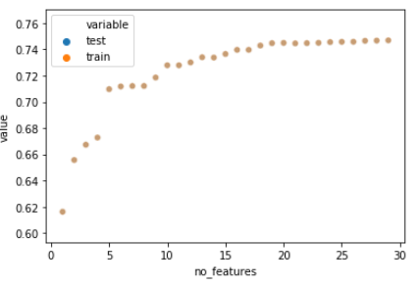
Selecting correct numer of variables with LR
auc train: 0.744
auc test: 0.715
Notes:
Mention

Slide 6
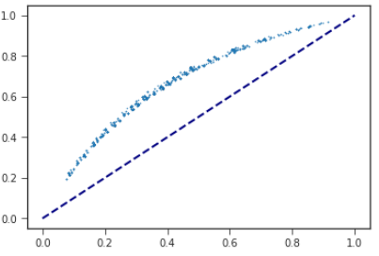
downsampling
Dropping observations at random
auc test: 0.7153
More advanced methods impossible

Slide 7
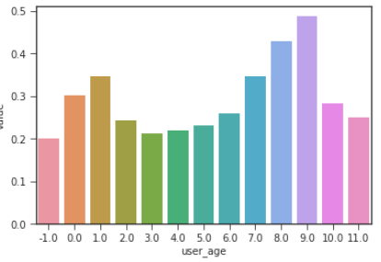
Feature generation
Binning age variable
Auc train: 0.751
Auc test: 0.721
Notes:
AUC for train set 0.7507490965479534
AUC for test set 0.7212623421651736

Slide 8
SVM
Using stochastic gradient descent for paralel computation
AUC train: 0.741
AUC test: 0.714

Slide 9
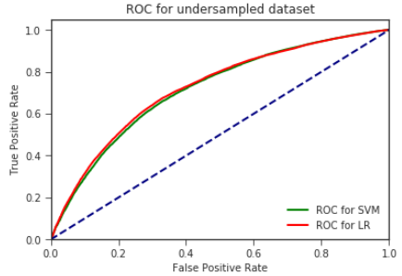
Final model
LR with regularization
Undersampled
20 features
+ 10 age dummies
AUC train: 0.751
AUC test: 0.721
Notes:
Same as ridge
Scores with best alpha at 10
0.751

Slide 10
Thank you

